Slide 1
An Najah University
DISTRIBUTED AUTOMATED BACKUP SYSTEM
Presented by Sara&Berlanti
Course: Computer Networks Project

Slide 2

An Najah University
ABSTRACT
This project presents a distributed system for automated data backup across multiple nodes without relying on a central server.
It focuses on automation, security, and decentralization.

Slide 3
An Najah University
OVERVIEW
Introduction
Problems
Proposed Solution
Core Concepts
Objectives
System Architecture
Technologies
How the System Works
Security
Recommendation
Conclusion

Slide 4

An Najah University
INTRODUCTION
This project addresses the need for reliable data backup in distributed environments.
It uses a multi-node system where each node works independently while contributing to a shared backup strategy.
The system focuses on automation, security, and scalability to ensure continuous data protection with minimal human intervention.

Slide 5
An Najah University
PROBLEMS
01
02
03
Single Point of Failure
Traditional backup systems rely on a single server, so if it fails, all backup data can be lost.
Lack of Automation
Many backup systems require manual execution, which increases human effort and the risk of forgetting or delaying backups.
Limited Scalability
Centralized systems become difficult to manage as the amount of data and number of devices increases.

Slide 6
An Najah University
Proposed Solution
We designed an automated distributed backup system where:
Each node works independently
Backups are executed automatically
Data is synchronized securely between nodes

Slide 7
An Najah University
OBJECTIVES
01
Design a Distributed Backup System
To build a system where multiple nodes work together without relying on a central server, improving reliability and fault tolerance.
02
Automate Backup Processes
To automate backup operations using scripts, reducing manual work and minimizing human errors.
03
Ensure Secure and Efficient Data Management
To secure communication between nodes using SSH and improve data handling efficiency through structured backup strategies.

Slide 8
An Najah University
System Architecture
The system consists of three Ubuntu virtual machines connected via a private network.
Each node includes:
Web interface
Backup engine
Automation scripts

Slide 9
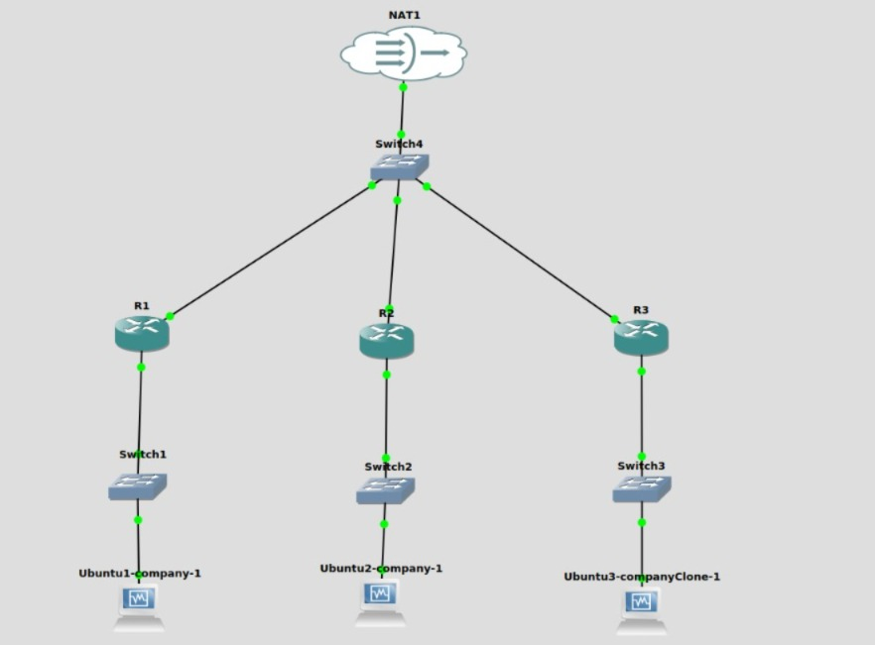
An Najah University
Our topology

Slide 10
An Najah University
CORE CONCEPTS
Distributed Systems
Automation
A distributed system is a group of independent nodes working together without a central server, improving reliability and scalability.
Automation means tasks are done automatically using scripts, reducing effort and errors.
Informatics Engineering | 2024

Slide 11
An Najah University
TECHNOLOGIES
Secure Communication (SSH)
File Synchronization (rsync)
Provides secure communication between nodes, allowing safe data transfer and remote execution.
A tool used to efficiently transfer and synchronize files by copying only modified data.

Slide 12
An Najah University
TECHNOLOGIES
Ubuntu Linux
Agents
An agent is a program that runs on each node and performs tasks automatically like backup and synchronization.
An operating system used to run the nodes and manage system operations and scripts.

Slide 13
An Najah University
TECHNOLOGIES
Bash Scripting
VirtualBox Networking
Used to automate backup, restore, and synchronization tasks directly on the system.
used to create and run multiple virtual machines on a single physical device, allowing us to simulate a distributed system environment.

Slide 14
An Najah University
How the System Works
Front End
User accesses node web interface
Clicks a button (Backup / Restore)
Back and
Agent receives the request Automation scripts are executed automatically Data is stored or synchronized

Slide 15
An Najah University
Incremental Backup
Only modified or newly added files are backed up.
Reduces Storage usage
Execution time
improves system efficiency

Slide 16
An Najah University
Security
SSH authentication between nodes
Secure internal network communication
No external exposure of sensitive data

Slide 17

An Najah University
CONCLUSION
This project provides a scalable, secure, and fully automated distributed backup system that eliminates manual work and avoids dependency on a central server.

Slide 18
An Najah University
RECOMMENDATION
Cloud Integration
Integrating cloud storage for additional backup reliability.
Develop a Central Monitoring Dashboard
A unified dashboard can be introduced to monitor all nodes from one interface, providing better control and system visibility.

Slide 19
An Najah University
THANK YOU
Presented by Sara&Berlanti
Course: Computer Networks Project

